Slide 1
Vision-Language Model Enhanced Imbalanced Learning
Zhuo Li
2023-06-10

Slide 2
Motivation
Data level:
Imbalanced image data and imbalanced text data, independently.
The joint distribution of image and text data is also imbalanced.
Training level:
Existing work about vision-language model for imbalanced learning demands heavily training consumption. (Parameters)
Vision prompt learning can serve to help decrease the needs of full training of the backbone networks. (ResNet50, ResNet152 and ViT)
Method level:
Extra text data only serves as a supplement to images.
There is no explicitly modeling about the data imbalance on the multi-modal level.

Slide 3
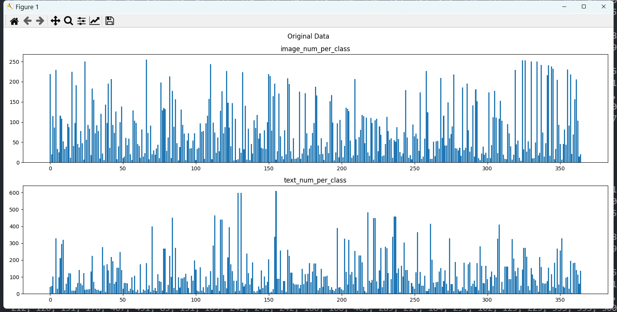
Data Analysis —— PlacesLT

Slide 4
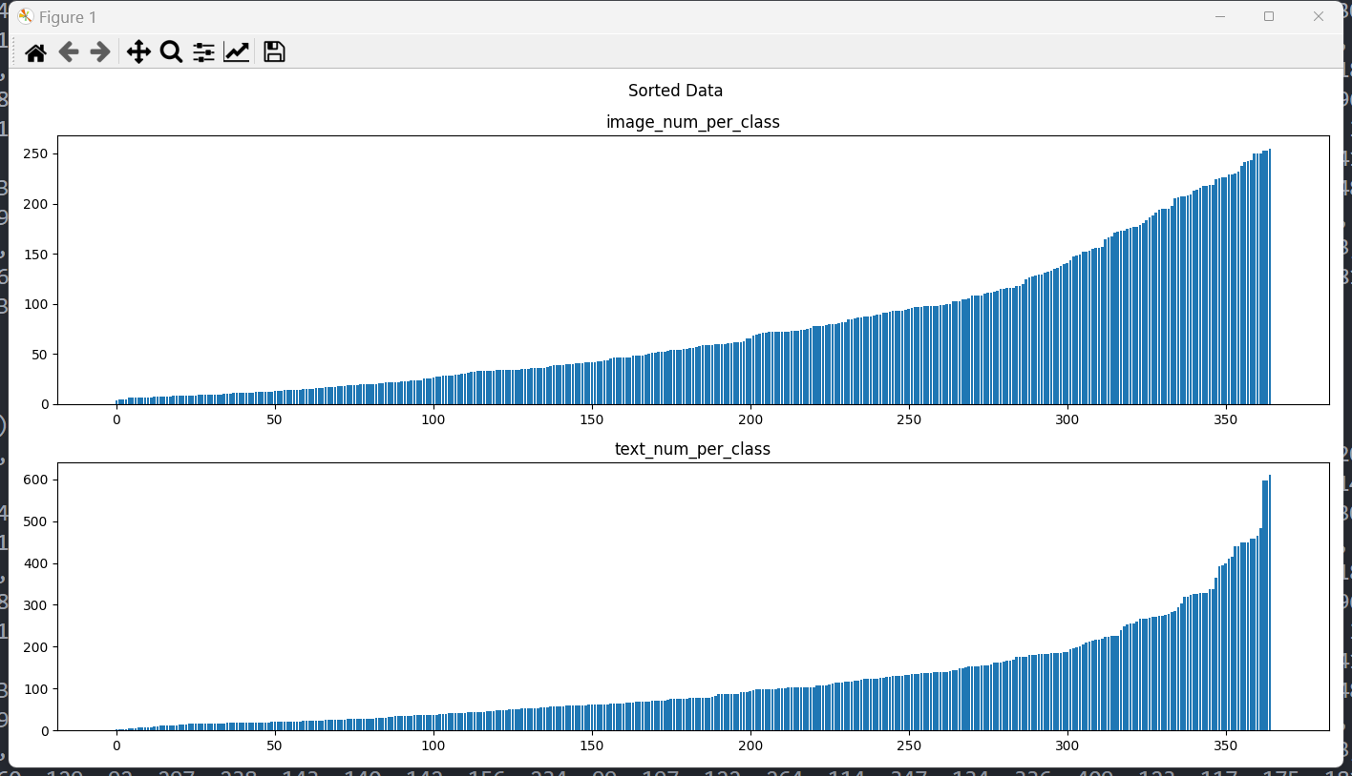
Data Analysis —— PlacesLT

Slide 5
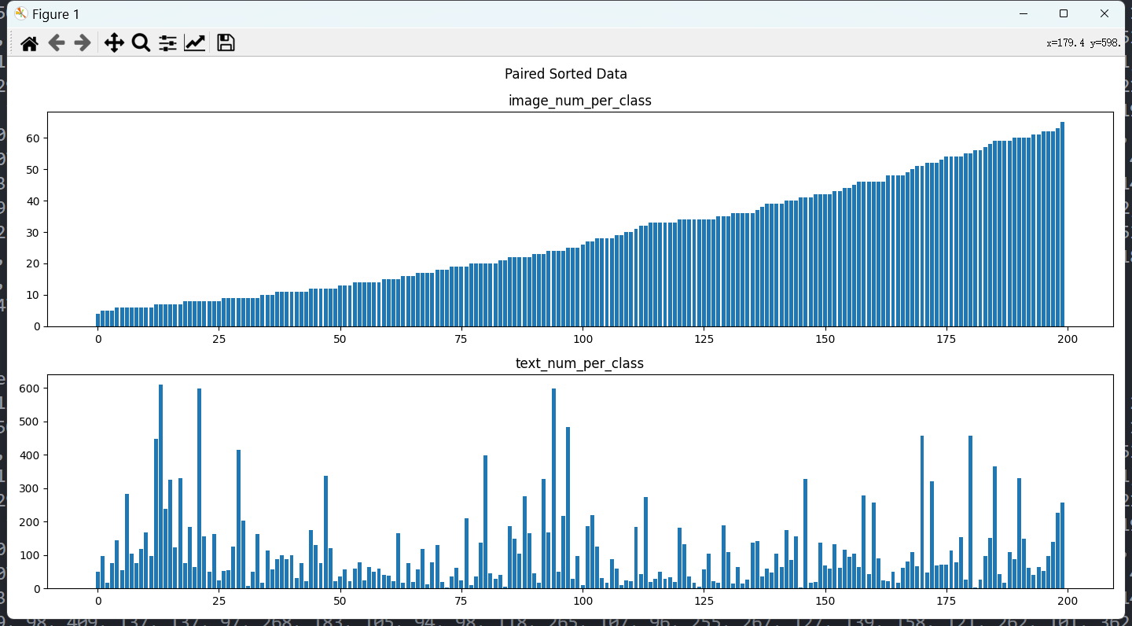
Data Analysis —— PlacesLT

Slide 6
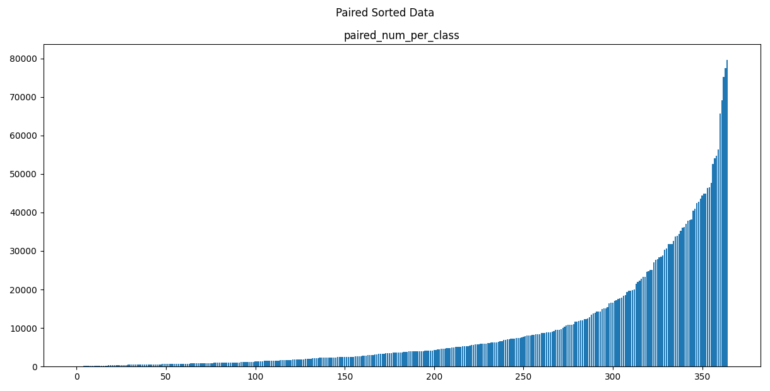
Data Analysis —— PlacesLT

Slide 7
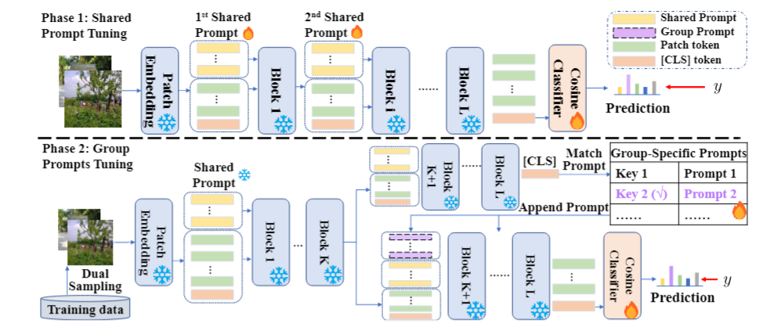
Previous work
Long-tail Vision Prompt Tuning
Freeze the pretrained backbone and optimize the trainable prompts to save training consumption.

Slide 8
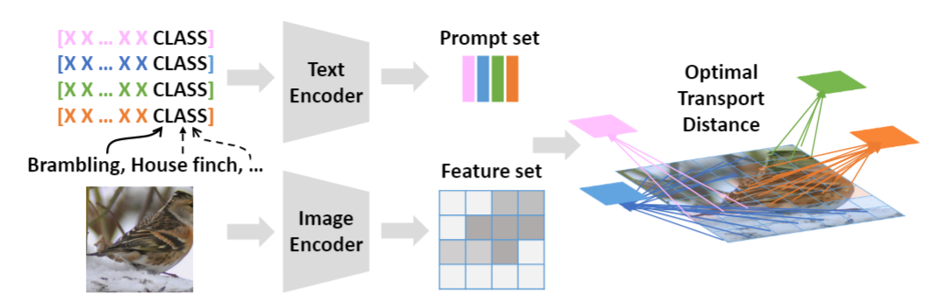
Previous work
OT based language-vision model pretraining
Formulate the local low vision features and multiple prompts as the samplings of two discrete distribution.

Slide 9
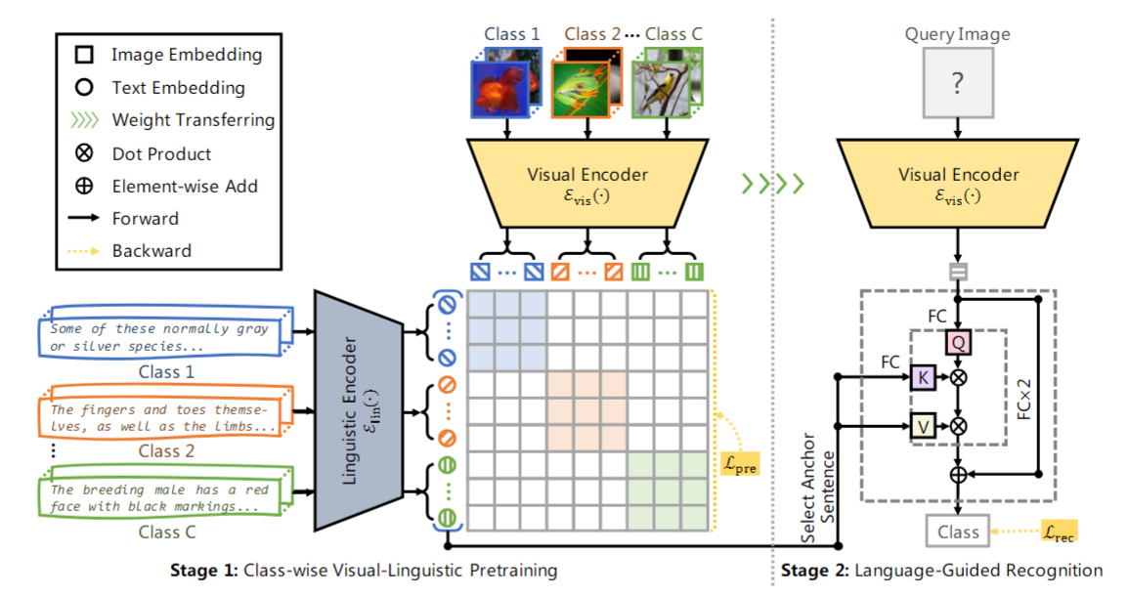
Previous work
Class-wise vision and language pretraining for imbalanced classification.

Slide 10
Method
Frozen Pretrained Clip
Trainable parameters
Training Phrase
Vision Prompts
Image
Encoder
Images
Text
Encoder
Texts
Inference Phrase
Use image encoder to extract vision features and then classify. Or classifier-free, such like Neural Collapse or OT plan as a classifier?
Use text encoder to select most similar text as the queries?

Slide 11
Method
How to model the imbalance?
Learning of the prompts. We can design a specific learnable prompt connected with the imbalance. This is also the motivation of prompt learning.
How to use the additional texts to help the imbalanced image learning?
OT as the controller to help build the connection between learning image prompts and text prompts.
Can we expand the neural collapse to two different modal?
Notes:
题外话，我们对样本的优化是不是已经可以理解为一种visual prompt了，它能够让k_0的样本变成k，

Slide 12
06-25

Slide 13
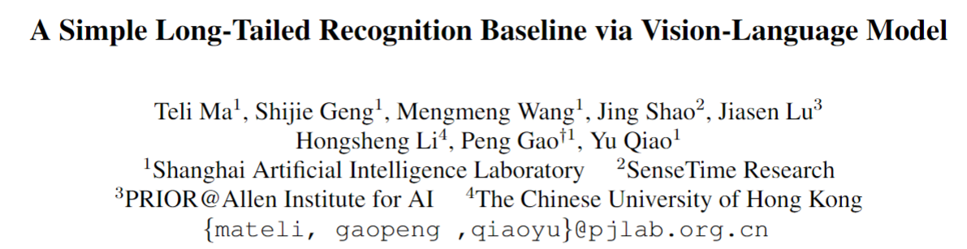
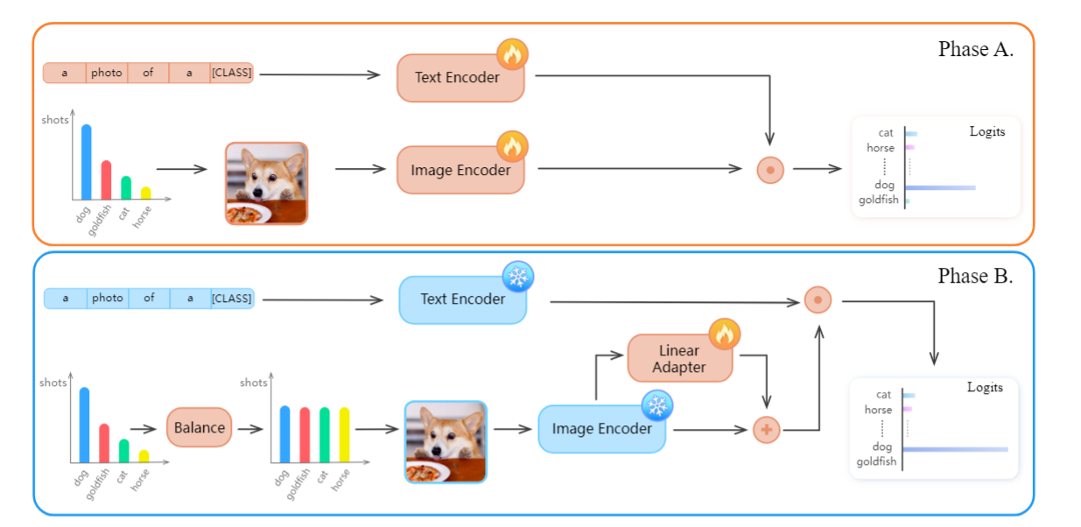
Motivation:
How pretrained visual-language model can enhance long-tailed recognition?

Slide 14
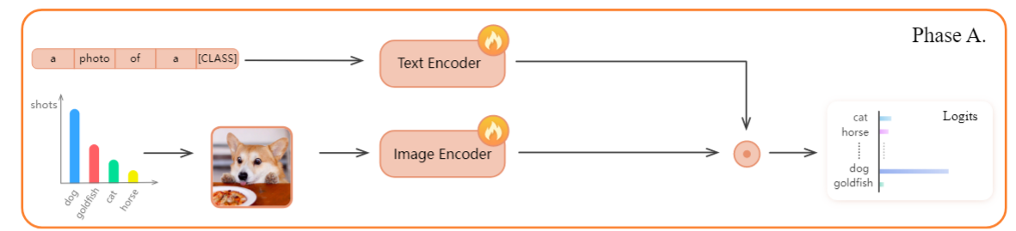
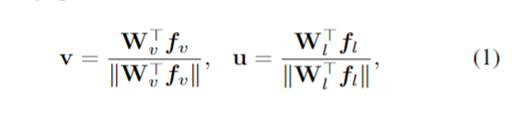
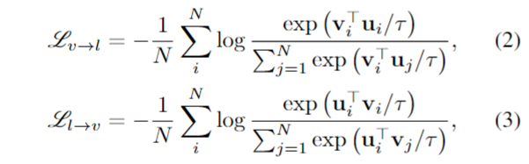
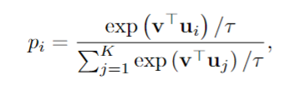
Method
Phase A. Further fine tuning on long-tailed dataset.
u
v

Slide 15
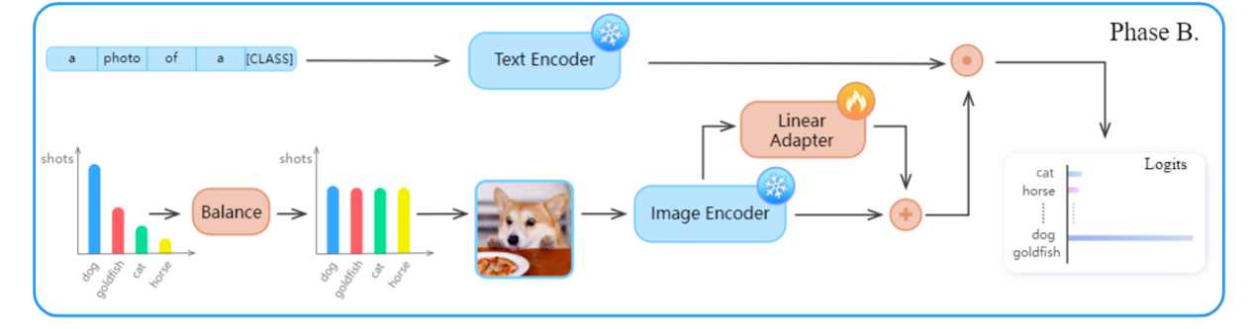

Method
Phase B. Freeze backbone and utilize an linear adapter layer to refine representation.
f
Linear Adapter layer to refine representation on infrequent classes by using a class-balanced sampling strategy.

Slide 16
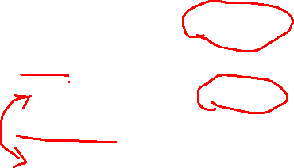
Exp
对比Handcraft prompt 和 learnable prompt的区别
Dataset | Prompt | Sampler | Top-1 Test Acc
Places-LT | Hand | None | 42.95
Places-LT | Hand | ClassWise | 50.00
Places-LT | Learnable | None | 42.68
Places-LT | Learnable | ClassWise | 48.97
Notes:
题外话，我们对样本的优化是不是已经可以理解为一种visual prompt了，它能够让k_0的样本变成k，

Slide 17
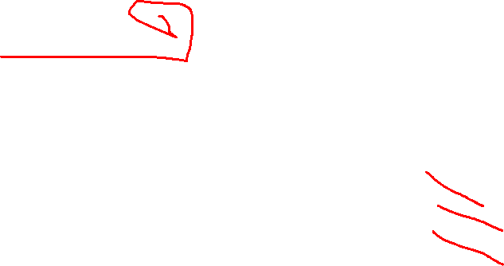
Exp
finetune CLIP的 必要性
Dataset | Model | Sampler | Top-1 Test Acc
Places-LT | CLIP | ClassWise | 38.80
Places-LT | CLIP+Adapter | ClassWise | 38.20
Places-LT | Phase B | ClassWise | 50.00
Notes:
题外话，我们对样本的优化是不是已经可以理解为一种visual prompt了，它能够让k_0的样本变成k，

Slide 18
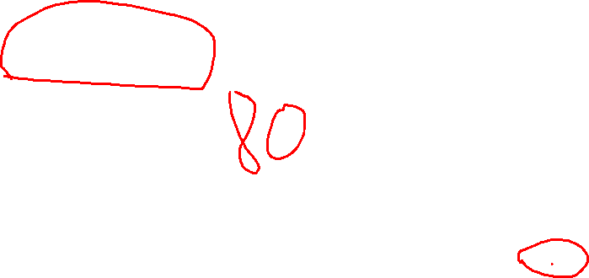
Exp
第二阶段引入多个prompt后取mean，再查询分类结果
Dataset | Model | Sampler | Prompt | Top-1 Test Acc
Places-LT | Phase B | ClassWise | 1 | 50
Places-LT | Phase B | ClassWise | 80 (不训练，直接mean后作为查询) | 48.60
Notes:
题外话，我们对样本的优化是不是已经可以理解为一种visual prompt了，它能够让k_0的样本变成k，

Slide 19
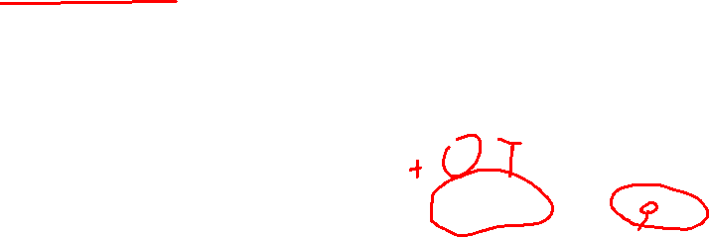
Exp
第二阶段引入triplet loss，加强正负样本对之间的约束
Dataset | Model | Sampler | loss | Top-1 Test Acc
Places-LT | Phase B | ClassWise | InfoLoss | 50
Places-LT | Phase B | ClassWise | InfoLoss + TripletLoss | 44.98
Places-LT | Phase B | ClassWise | TripletLoss | 不收敛
Notes:
题外话，我们对样本的优化是不是已经可以理解为一种visual prompt了，它能够让k_0的样本变成k，

Slide 20
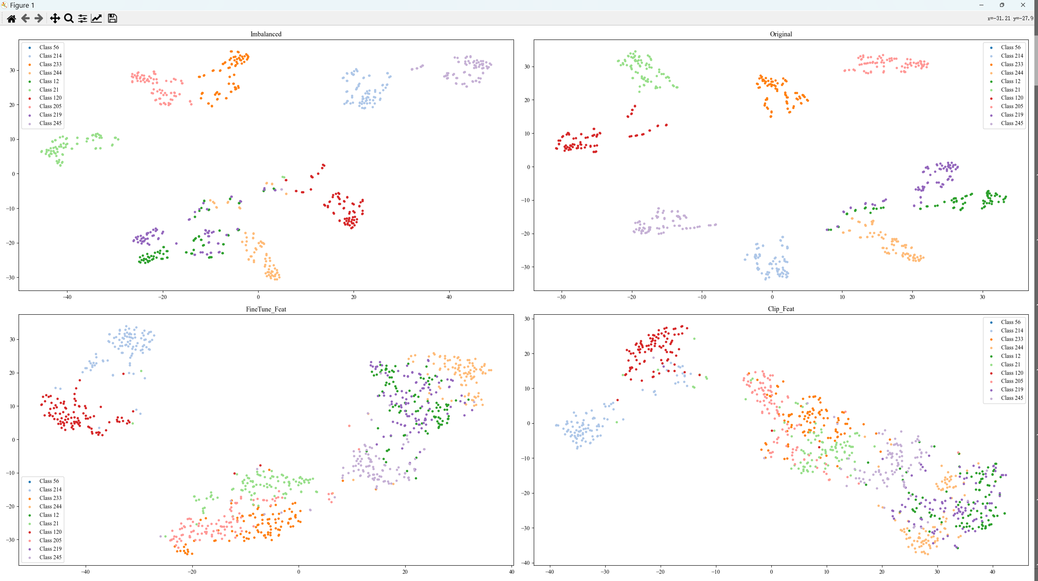
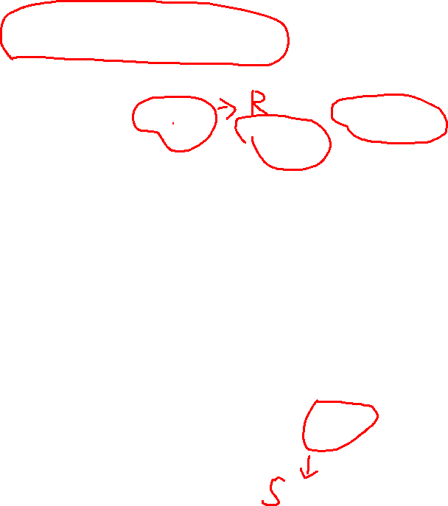
Distribution Visualization —— 分类精度最差的10类
Imbalanced finetuned CLIP
Vanilla CLIP
Notes:
题外话，我们对样本的优化是不是已经可以理解为一种visual prompt了，它能够让k_0的样本变成k，

Slide 21
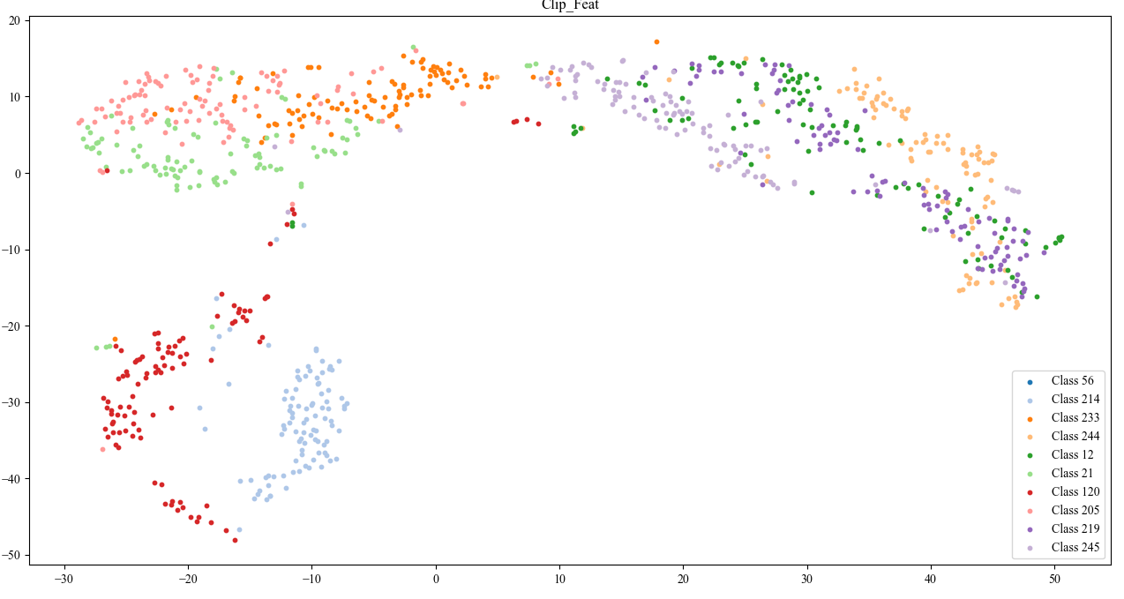
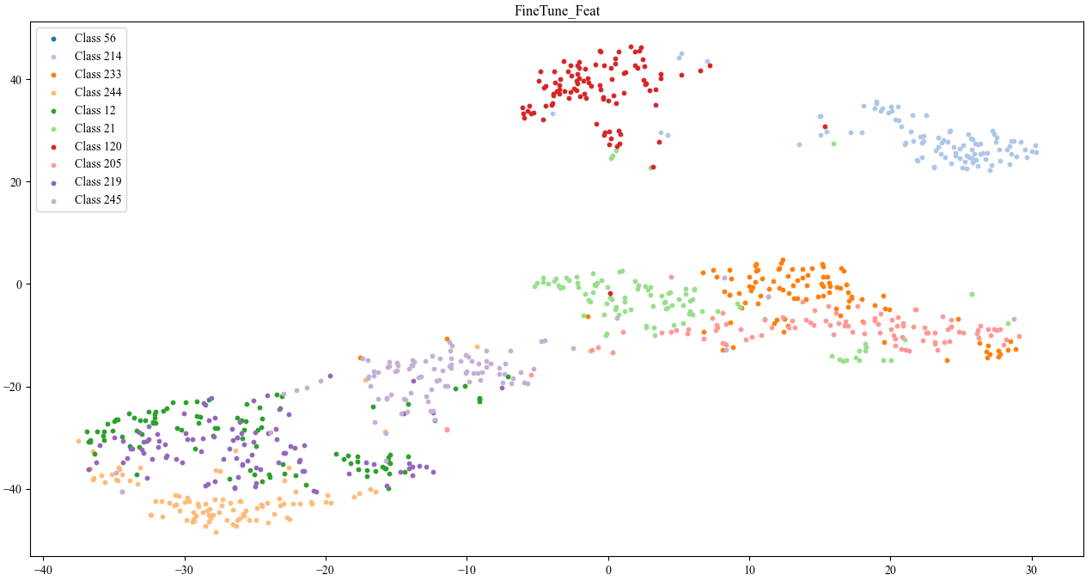
Logits 分布。
下面是图像的feature分布，上面是logits的分布。Logits是features * text.T
Logits 表现出更糟糕的不同类之间的纠缠现象。
Notes:
题外话，我们对样本的优化是不是已经可以理解为一种visual prompt了，它能够让k_0的样本变成k，

Slide 22
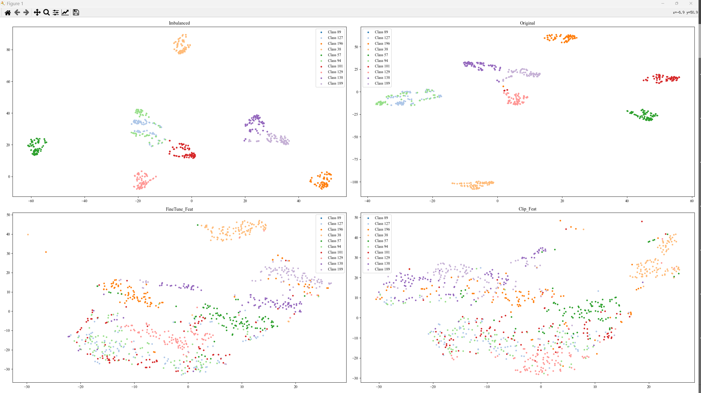
Distribution Visualization —— 训练样本数量最少的10类
上面是标签的分布。
下左是图像特征的分布，下右是logits的分布
Notes:
题外话，我们对样本的优化是不是已经可以理解为一种visual prompt了，它能够让k_0的样本变成k，

